Slide 3
Personal Style

Slide 4
Your Personal Style
Organizing & Design is not a One-Size-Fits-All
Determining your visual style & owning your natural tendencies will help you design a system that will lead to success you can maintain.
There is no right or wrong - it’s your home and your personal style.
Let’s talk about 2 basic design styles that are trending right now.

Slide 5
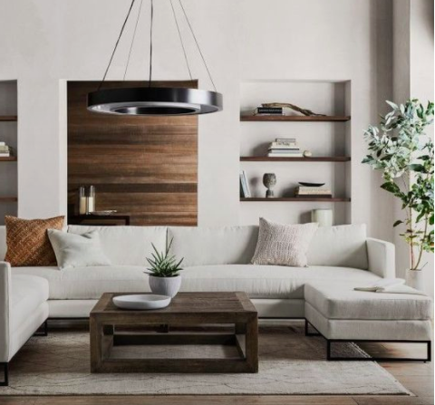
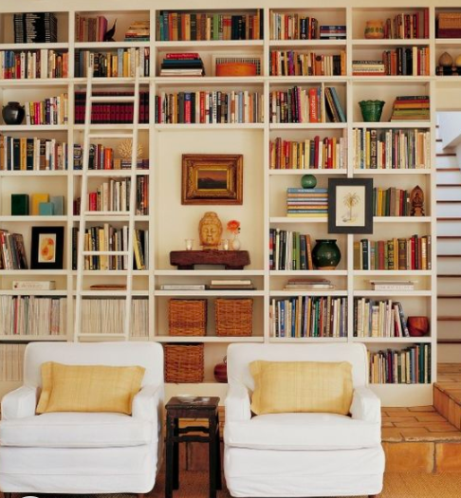
Are you a Minimalist or Maximalist
OR

Slide 6
“Your home should be a reflection of how you want to live right now, and for the next phase of your life.”
Martha Stewart

Slide 7
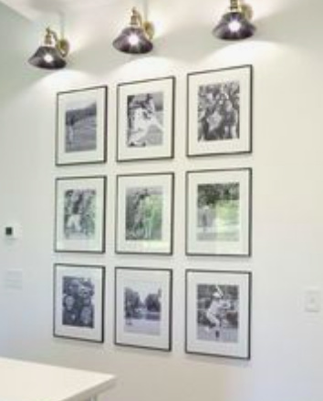
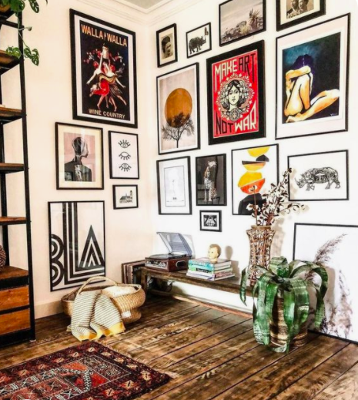
Minimalist * Maximalist

Slide 8
Visual Organizer - Like to see your items (open shelving & clear containers, hooks on wall). You like visual abundance.
Vs
Hidden Organizer - Like things put away (drawers, cabinets & baskets, coats & bags in closets). You like visual simplicity.

Slide 9
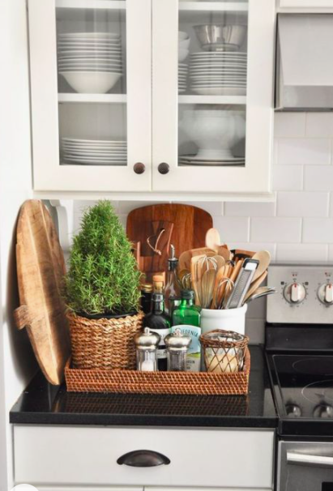
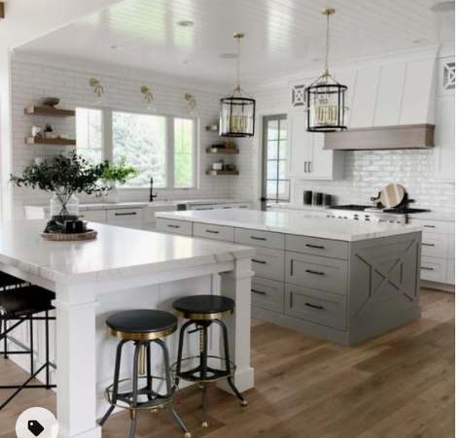
Visual vs. Hidden

Slide 10
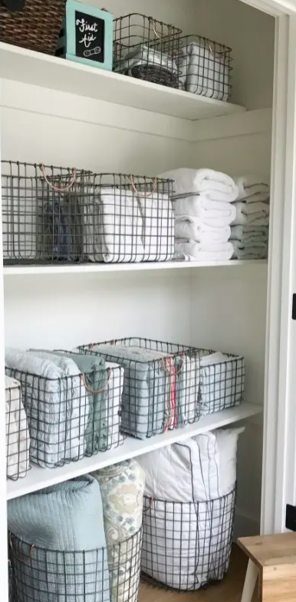
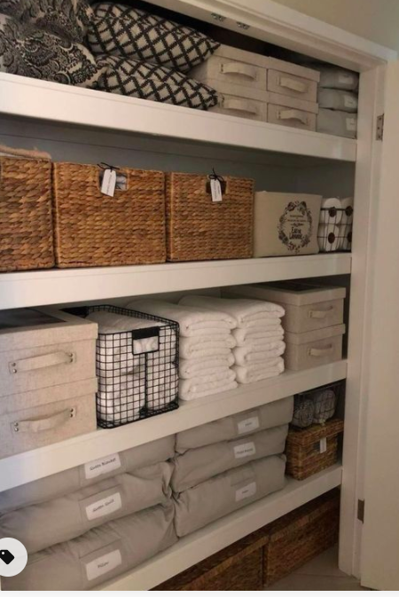
Visual vs. Hidden

Slide 11
Visual Style
*You love visual abundance.
*Prefer to see your important and everyday items (ex: toaster, makeup).
*Will tend to have clutter in visual areas.
*Tend to have the most perceived clutter.
*Tend to leave your things out wherever you used them last.

Slide 12
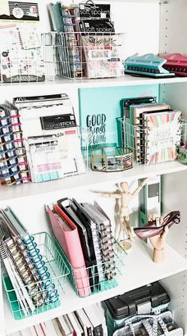
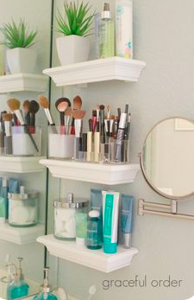
Visual Storage

Slide 13
Hidden Style
*You love visual simplicity.
*Traditional / classic organizer. Most books/magazines/shows cater to this style.
*Prefer their items out of sight. Will tend to have clutter in hidden areas (closets, drawers).
*Prefer your everyday used items hidden out of sight.
**You know you’re a Hidden Style if your surfaces are clean and tidy but your junk drawer is overflowing and you would be embarrassed if guests opened your closets.

Slide 14
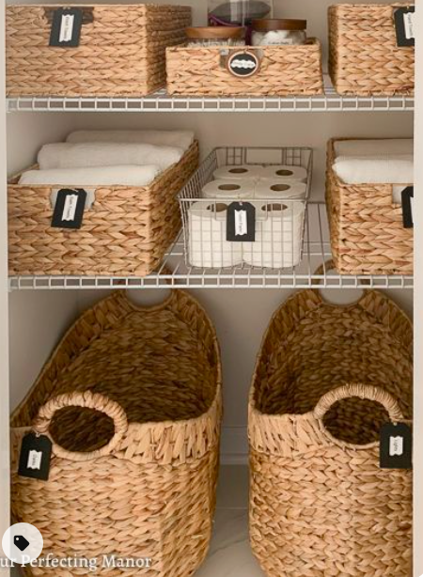
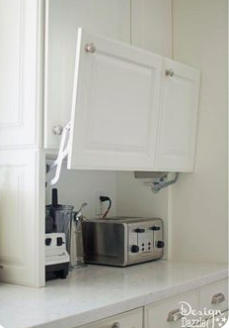
Hidden Storage

Slide 15
*Time Check*

Slide 16
Macro vs Micro
Macro Thinkers: They think in the big picture / the end goal - large containers/drawers/closets to put things into. Faster/easier.
vs
Micro Thinkers: They think in details - separate into smaller categories - will wait until they can organize in detail before starting project. They are also planners.

Slide 17
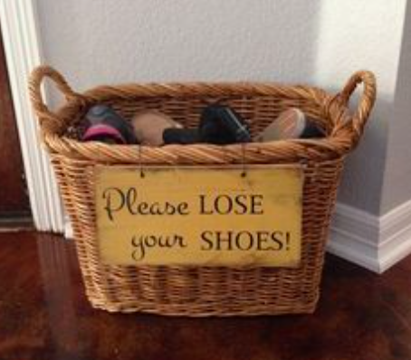
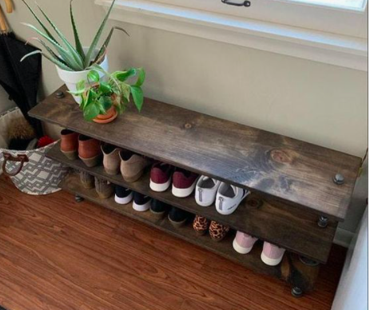
Macro vs Micro

Slide 18
Micro Thinker
*Love organizational abundance.
*Tend to be perfectionists and like things done a certain way.
*Because Micro organizing can be time consuming, they tend to procrastinate until it can be done perfectly.
*Struggle with indecision and they can over plan.
**If also a Hidden Style, the tendency for perfection can outweigh the need for having things out of sight. Projects will stay visual until completed.

Slide 19
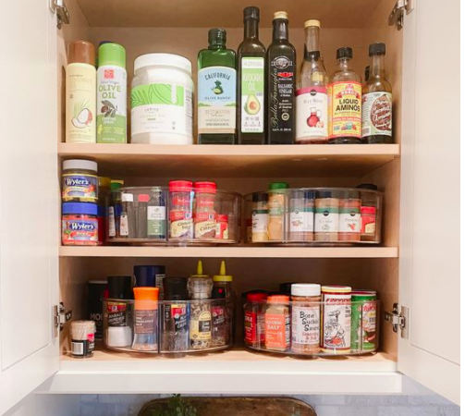
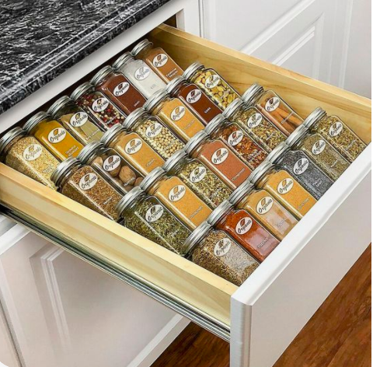
Macro vs Micro

Slide 20
Macro Thinker
*Love organizational simplicity.
*Need fast and easy systems in order to put your items away.
*Overwhelmed with traditional organizing solutions.
*Need storage that is visible and/or clearly labeled.
**If something is hard to put away properly, you probably won’t. Without a system in place, stuff can get shoved here, there and everywhere!

Slide 21
Compromising different styles in one space.
*Default to the Visual & Macro styles.
*It's easier for a Hidden Organizer to have visual storage
than to force a Visual to maintain the hidden style.
*It’s also much easier to organize in big categories.

Slide 22
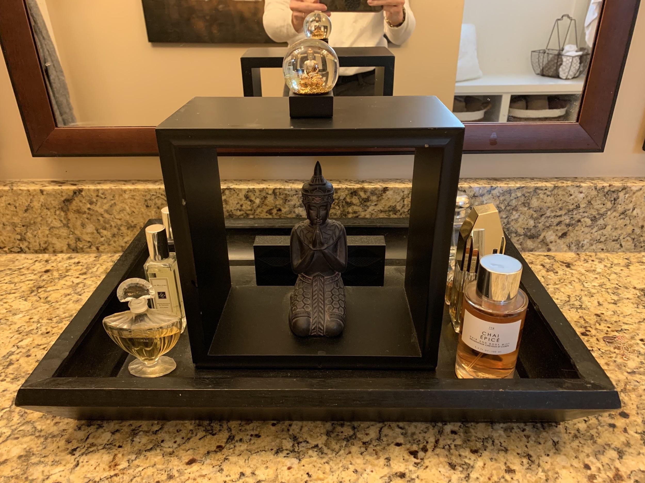
my bathroom counter tray...
I’m a Hidden Macro Organizer at home but I live with a Visual Macro.

Slide 23
“Your home should be the antidote to stress, not the cause of it.”
Peter Walsh

Slide 24
*Time Check*

Slide 25
Key spaces to Focus on that affect mood.
Bedroom, Bathroom, Entrance/Exit

Slide 26
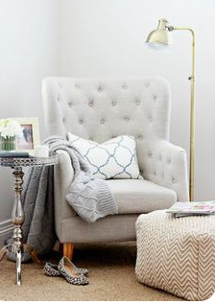
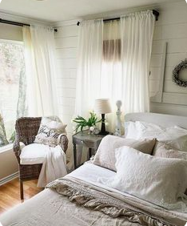
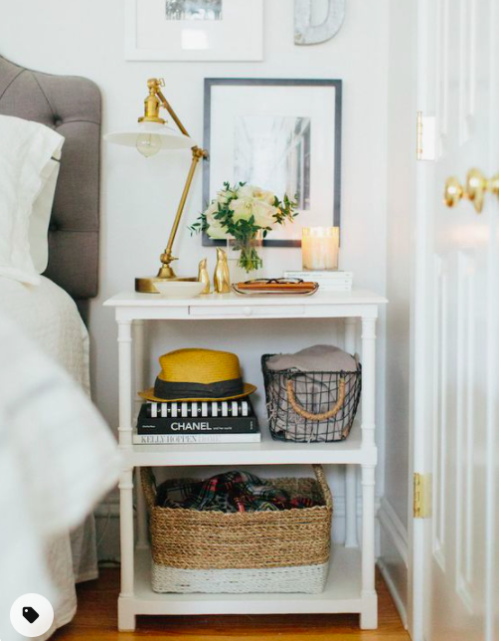
Make Your Bedroom into a Sanctuary

Slide 27
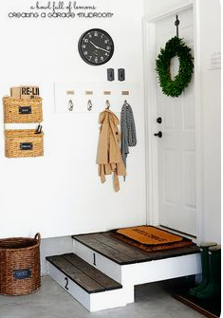
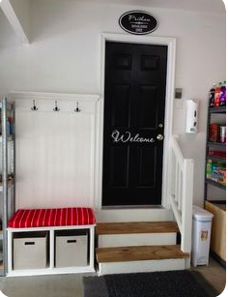
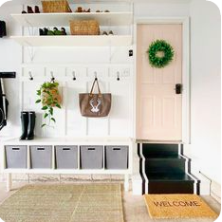
Where you enter/exit your home ...

Slide 28
#3 Organizing Action Steps & Tricks
Start Small - See results quickly
- Stay motivated
Celebrate

Slide 29
Tips & Tricks
*Make your bed it’s the dominant feature and will make the whole room feel tidy.
*Keep a donation tote or basket near each closet.
*Buy uniform hangers, it will instantly upscale your closet.
*Take Aspirational or Sentimental clothing out of main closet - they’re taking up valuable space - Physically & Mentally.
*Average household needs only 3 towels per person.
*Open mail by the recycling bin.

Slide 30
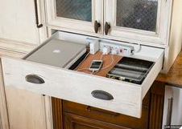
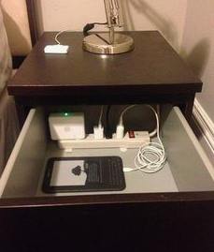
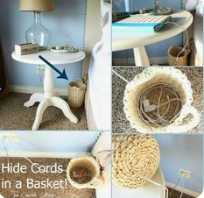
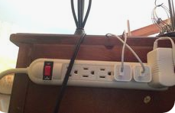
Electronics are here to stay - deal with them ...

Slide 31
Tip: Stop in the doorway, close eyes, step into the room … what area / item is the first thing you see?
Organize and decorate that space - it will change the whole room.

Slide 32
“The secret to getting ahead is getting started”
Mark Twain

